Slide 1
Graphical Passwords
PRESENTATION - 1
Supriya Arun, Zack Davis, Joanna John

Slide 2

Agenda
Purpose
Technical Platforms
Storyboards

Slide 3
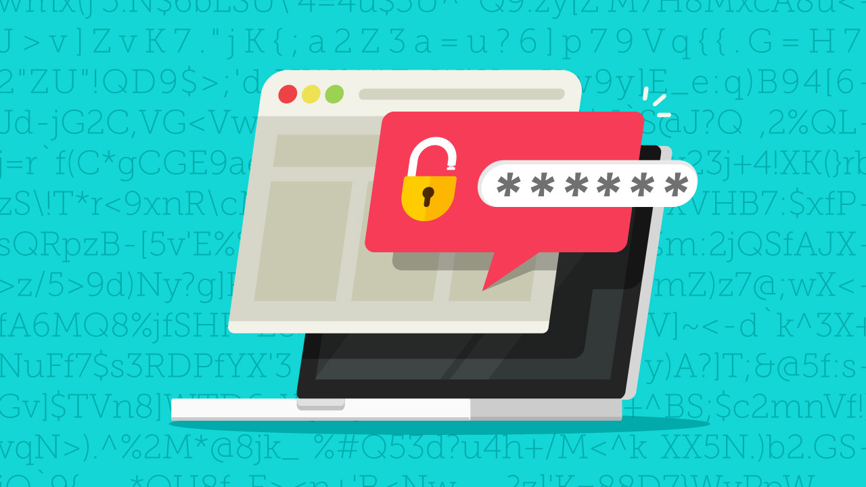
Purpose
Graphical Password application allows the user to set a pattern password.
The pattern are some set of images which randomly changes its position every time you try to login.
The user has to provide his details for registration and then has to pick the images as a password.
Every time the user logs in, they have to pick the images that they selected while creating the password.
Tightens security
Helps in creating more memorable passwords

Slide 4


Technical Platforms
Flutter is an open-source UI software development kit created by Google. It is used to develop cross platform applications for Android, iOS, Linux, macOS, Windows, Google Fuchsia, and the web from a single codebase.
The major components of Flutter include the Dart platform, Flutter engine, foundation library, design-specific widgets, and Flutter development tools.
Android emulator
Cloud Firestore scalable, flexible database via Firebase.
Firebase is a Backend-as-a-Service (BaaS) app development platform that provides hosted backend services such as a realtime database, cloud storage, authentication, crash reporting, machine learning, remote configuration, and hosting for your static files.

Slide 5
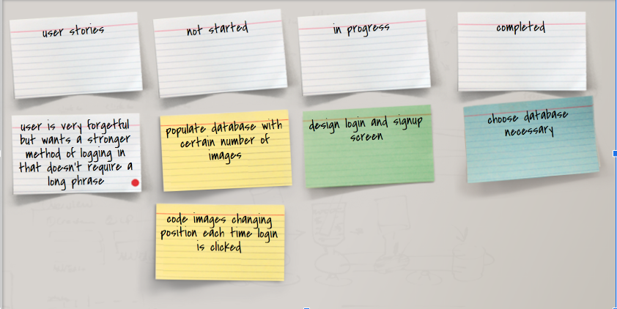
Storyboard

Slide 6
User Story
Alice is tired of writing down passwords but she does not want to keep all her passwords in an online password manager because she’s feels like she’ll get her passwords hacked with them.
Instead of remembering long phrases or unique strings of numbers and letters for a password, she decides to create a graphical password which lets her remember her preferred order of pictures that she wants to be her password.
First, she will create an account by clicking the sign up button. The app will send a query to the database and check if the username is available and valid. Once the username is accepted, a collage of images will be sent and she will be able to choose 4-6 images in whatever image of her choosing. That sequence will then be saved as her password to be ready to use.

Slide 7
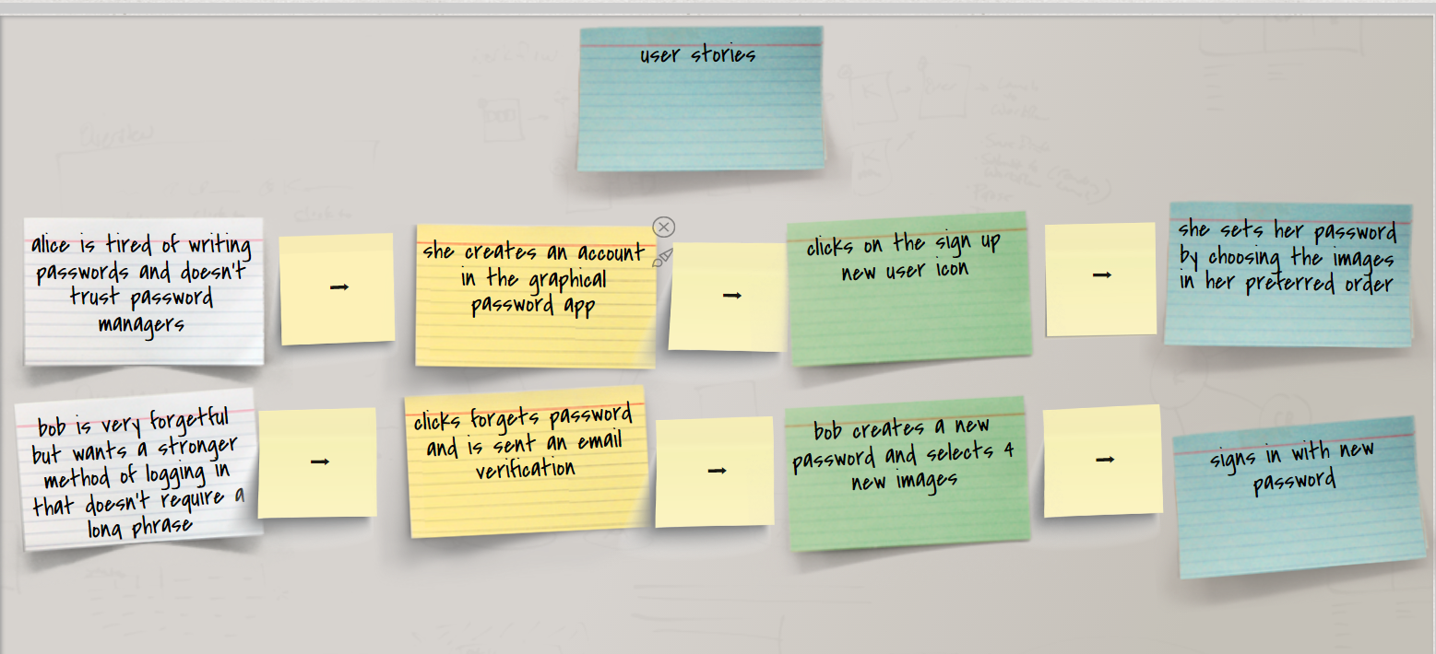
Storyboard

Slide 8
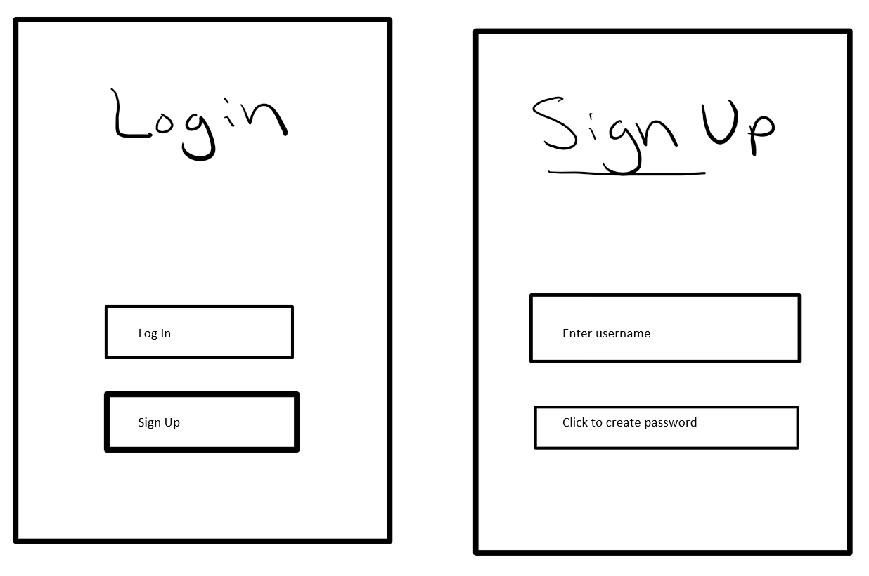
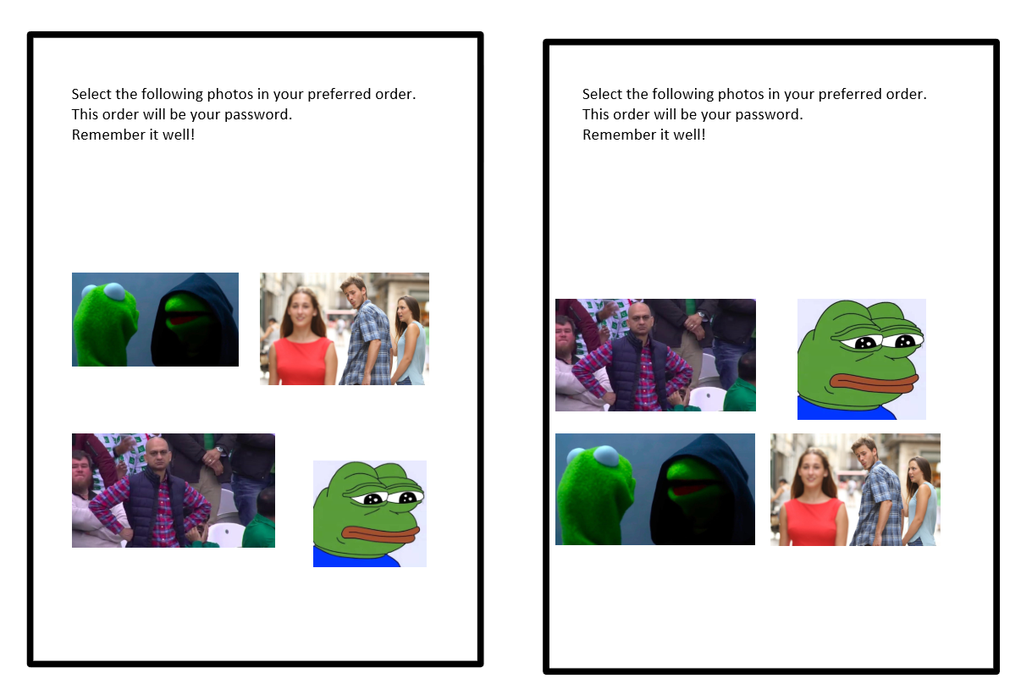
Demo Preview

Slide 9
Thank you

